Slide 1
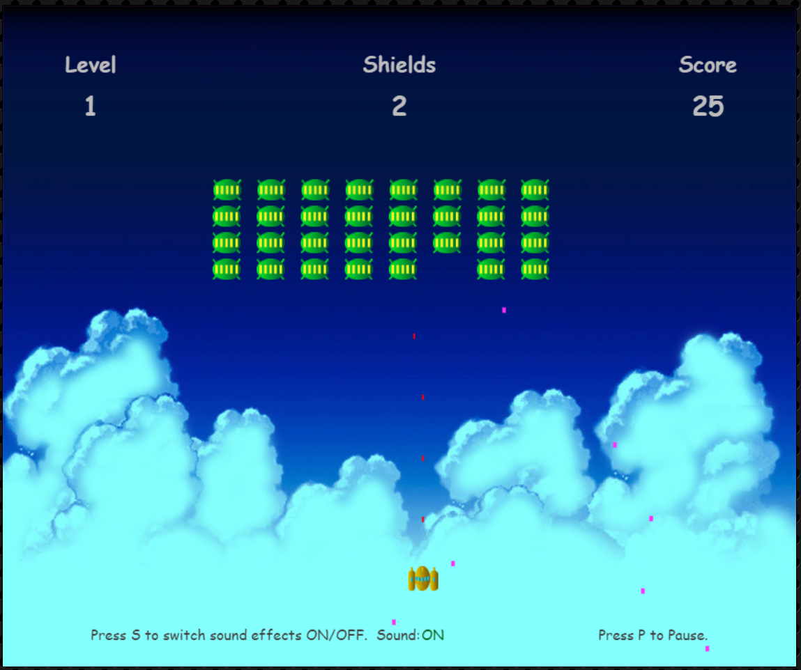
Game plan
Realized game

